Slide 1
Presentation Title : Lightweight Directory Access Protocol (LDAP) Network Time Protocol (NTP)

Slide 2
Hello!
I am Kedar Sitaram Jadhav

Slide 3
Topic overview
Understanding of LDAP
LDAP Servers
Protocol Overview
LDAP Operation
How to Use LDAP
Overview of NTP
NTP Architectural Overview
How NTP Works
NTP Clients and Serves
NTP Security Protocol and Model

Slide 4
Understanding of LDAP
Lightweight Directory access protocol
Open network protocol standard design to provide access to distributed directories.
Using TCP/IP protocol
The phrase “write once read many times” describe the best use of LDAP.
No Transaction, No Rollback.

Slide 5
LDAP Servers
Active Directory from Microsoft
Apache Directory Server
Apple open Directory
IBM Tivoli Directory Server
Novell eDirectory
OpenLDAP
Oracle Internet Directory
Sun Java System Directory Server

Slide 6
LDAP Protocol Overview
Client starts an LDAP session by connecting to an LDAP server.
The Default TCP Port is 389.
Bind to the LDAP Server.
Client then sends an operation request to the server.
The server sends response in return.

Slide 7
LDAP Operations
Operation | What is does
Search | Search directory for matching directory entries
Add | Add new directory entry
Modify/ Delete | Modify/Delete a particular directory entry
Compare | Compare directory entry to a set of attributes
Abandon | Abandon an operation previously sent to the server
Extend | Extend operations command

Slide 8
How to Use LDAP
Can use any Java LDAP SDK, for example:
JNDI LDAP Standard
Spring LDAP: http://www.springsource.org/ldap
- (it is better to use it when using spring framework)
LDAP API : from Apache
http://cwiki.apache.org/confluence/display/LDAPAPI/Index
Netscape LDAP
http://www-archive.mozilla.org/directory/javasdk.html

Slide 9
Overview of NTP
Network Time Protocol(NTP) synchronize clocks of hosts and routers in the internet.
In operation since before 1985, NTP is one of the oldest Internet protocols in current use. NTP was designed by David L. Mills of the University of Delaware.
Well over 100,000 NTP peers deployed in the internet and its tributaries all over the world.
NTP can usually maintain time to within tens of milliseconds over the public Internet, and can achieve better than one millisecond accuracy in local area networks under ideal conditions.
The current protocol is version 4 (NTPv4), which is a proposed standard as documented in RFC 5905. It is backward compatible with version 3, specified in RFC 1305.
Network Time Security (NTS), a secure version of NTP with TLS and AEAD is currently a proposed standard and documented in RFC 8915

Slide 10
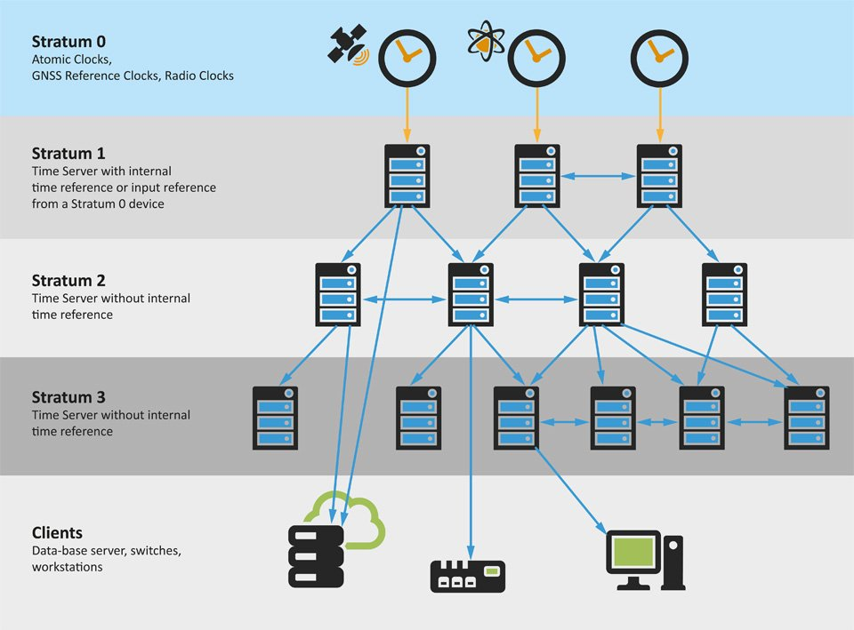
NTP Architectural overview
Peer process runs when a packet is received.
Poll process sends packets at intervals determined by the clock discipline process and remote server.
System process runs when a new update is received.
Clock discipline process implements clock time adjustments.
Clock adjust process implements periodic clock frequency (VFO) adjustments.

Slide 11
How NTP Works
Multiple synchronization peers provide redundancy and diversity.
Clocks filters select best from a window of eight clock offset sample.
Intersection and clustering algorithms pick best subset of servers delivered to be accurate and fault free.
Combing algorithm computes weighted average of offsets for best accuracy.

Slide 12
NTP Clients and Servers
(a) Workstations use multicast mode with multiple department servers
(b) Department servers use client/server modes with multiple campus servers and symmetric modes with each other
(c) Campus servers use client/server modes with up to six different external primary servers and symmetric modes with each other and external secondary (buddy) servers

Slide 13
NTP Security Protocol
NTP is not like other protocols that depend on a reliable time infrastructure. NTP is the time infrastructure. So, how do we reliably authenticate NTP servers to dependent clients?
NTP can’t use the conventional PKI infrastructure, as it can’t trust signatures unless the period of validity can be verified.
NTP has to build its own infrastructure using timestamped certificates and crafted zero-knowledge proofs.

Slide 14
NTP Security Model
It authenticates the server to the client, not the other way around.
It must be based on public key cryptography using Internet PKI and standard certificates with verified period of validity.
It must interoperate with existing NTP protocol modes (including broadcast) and symmetric key cryptography.
It must provide for the independent collection of cryptographic values and time values.
It must be resistant to cryptographic attacks. It must tolerate occasional lost, duplicate or out of order packets.
All cryptographic algorithms must be obtained from public cryptographic libraries (OpenSSL).

Slide 15
Thanks!

